Slide 1
Education for All Fundraising Campaign
Data-Driven Insights for Optimizing Donations
By: Frederick Ighodalo

Slide 2
Introduction
Overview: Introduction to the fundraising campaign and the importance of data-driven decisions.
Purpose: To provide insights from the dataset to help optimize fundraising efforts.

Slide 3
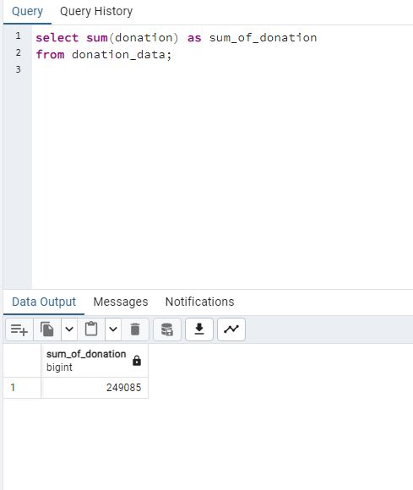
Total Donation Amount

Slide 4
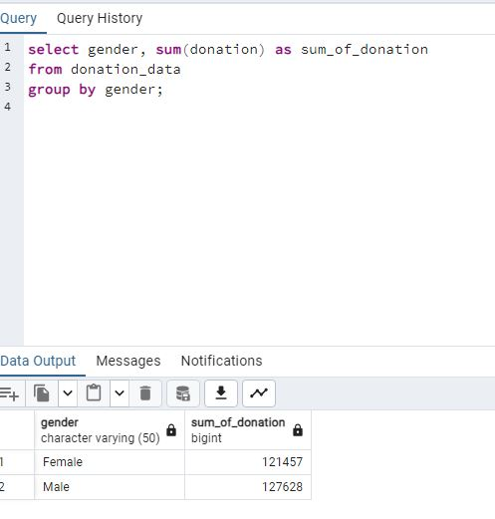
Total Donation by Gender

Slide 5
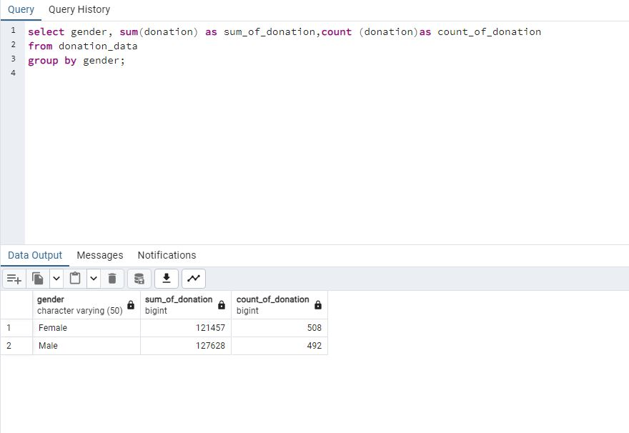
Total Donation and Number of Donations by Gender

Slide 6
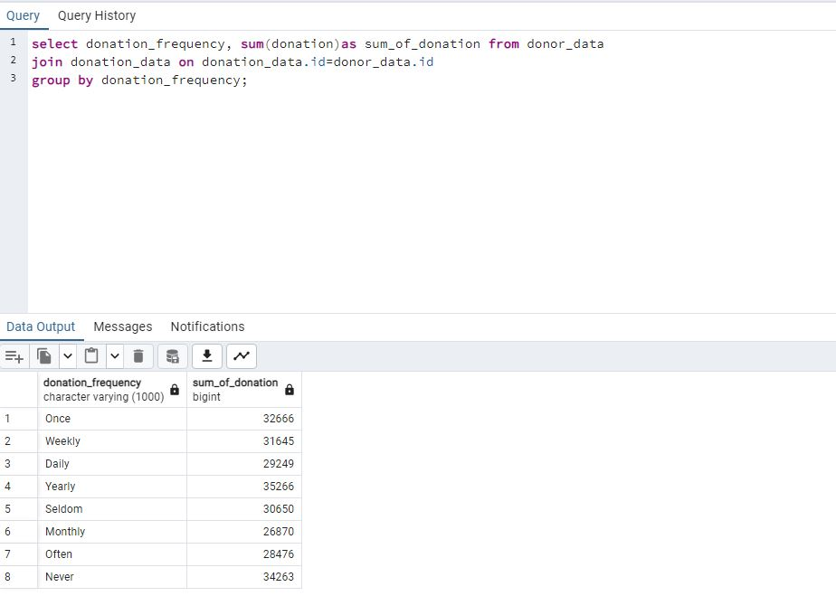
Total Donation by Frequency of Donation

Slide 7
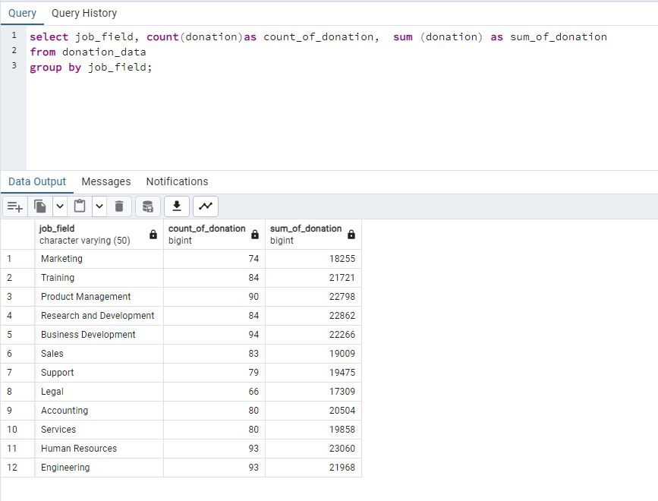
Total Donation and Number by Job Field

Slide 8
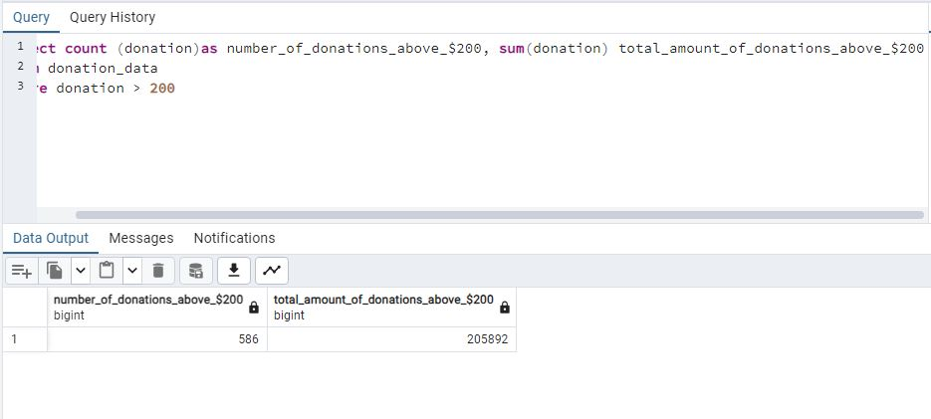
Donations Above $200

Slide 9
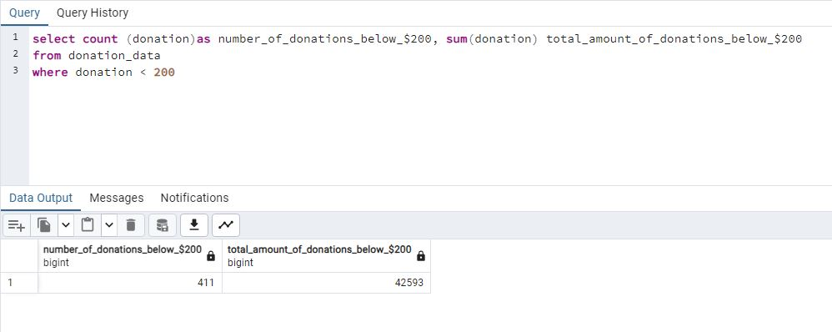
Donations Below $200

Slide 10
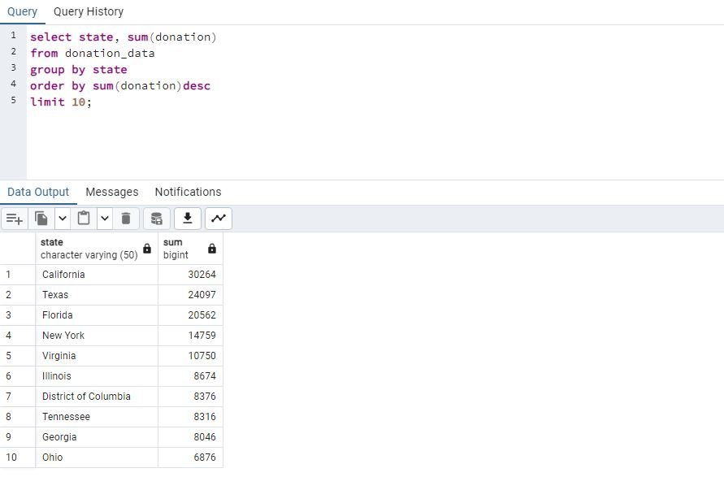
Top 10 States by Highest Donations

Slide 11
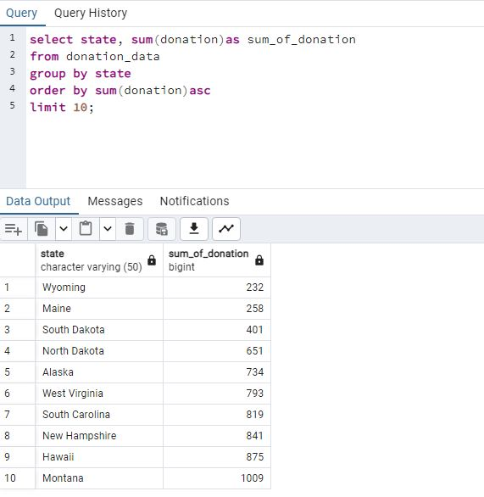
Top 10 States by Least Donations

Slide 12
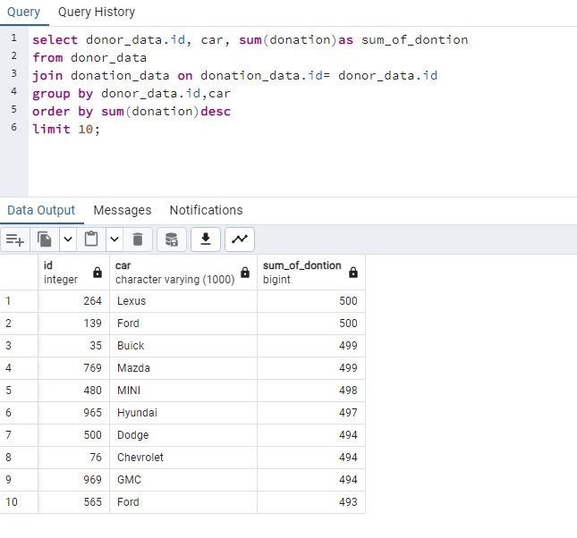
Top 10 Cars Driven by Highest Donors

Slide 13
Conclusion
Using SQL to analyze donation data provides valuable insights.
These insights help in understanding donor behavior and optimizing fundraising strategies.
By targeting specific demographics and donation patterns, we can enhance our fundraising efforts and achieve our mission of "Education for All".
Thank you for your attention.

